Slide 1

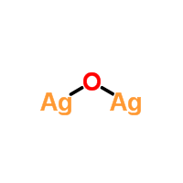
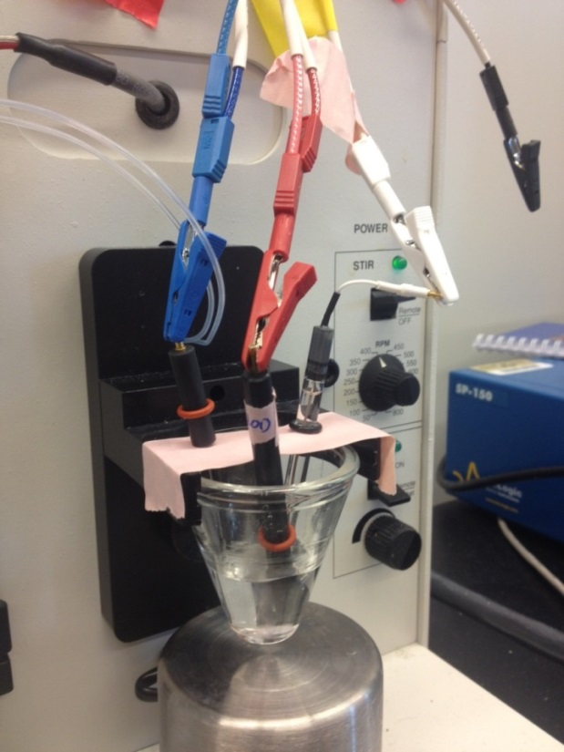
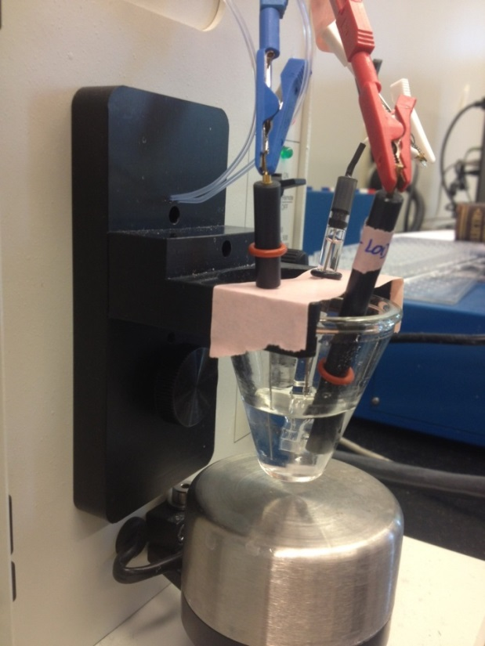
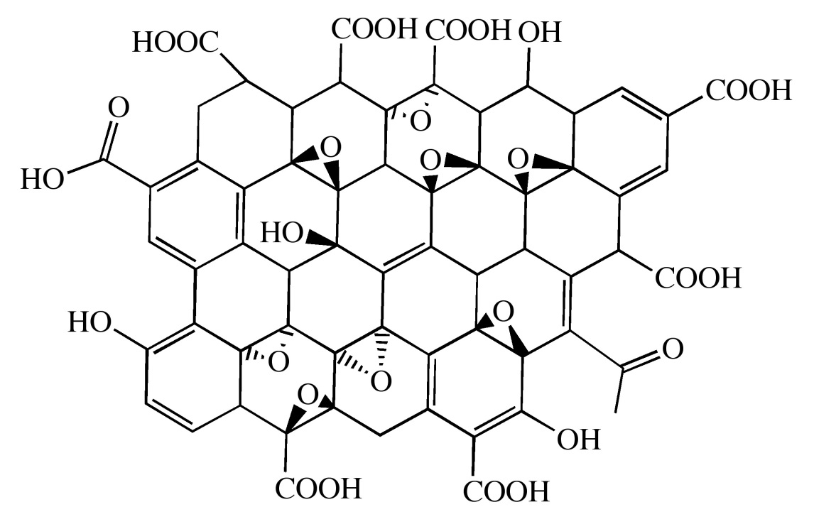
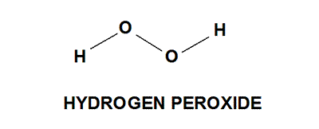
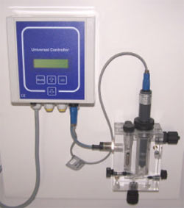
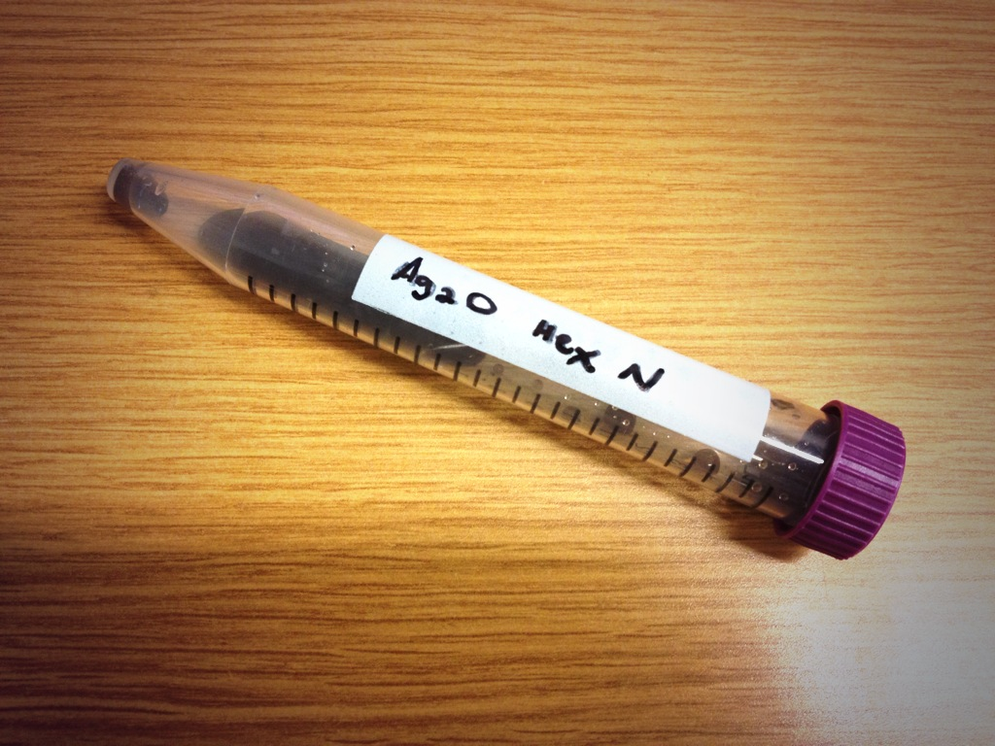


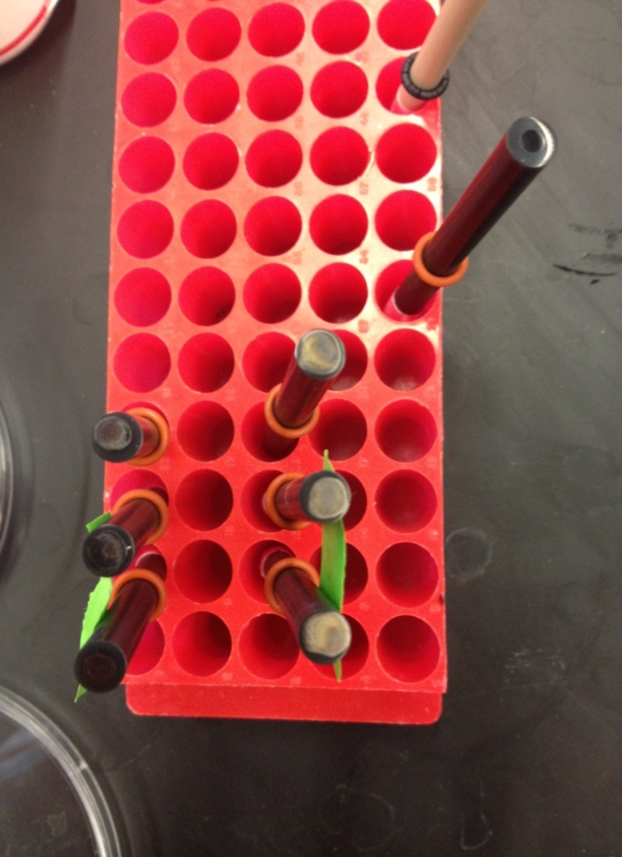

Silver(I) Oxide-Graphene Oxide Sensor for Hydrogen Peroxide
Austin Scherbarth, Professor Lia Stanciu, Alexandra Snyder, Isabella Ramirez
School of Materials Engineering, Purdue University, West Lafayette, IN
Introduction
Methodology
In-Situ Oxidative Polymerization via Spin Coating
Results and Discussion
Metal oxides are widely used in sensors and for various electrochemical research studies and applications. In this study, Silver(I) Oxide (Ag₂O) was used.
Graphene oxide(GO) and metal oxides, such as Ag₂O, are often used in sensors because of their surface area and electrochemical properties.
Hydrogen peroxide is hard to detect and can be toxic at certain concentrations.
Synthesize shaped Ag₂O particles.
Coat glassy carbon electrodes with Ag₂O and/or GO layer by layer.
Perform electrochemical tests on coated electrodes.
Cyclic voltammetry graphs (below, left) for each system which show how the current changes with applied potential.
Testing a given system’s hydrogen peroxide detecting abilities is done by connecting the electrode to be tested to the electrochemical cell shown in the above photographs. A constant potential is applied to the system, hydrogen peroxide is added, and the change in current (current response) is observed. This response shows how well the system can sense when hydrogen peroxide is present.
Histogram (above, right) shows the average current response to hydrogen peroxide for the various systems. The electrodes coated with hexapod-shaped Ag₂O show the best current response with and without GO
Objectives
Calibration curve showing the change in current response over time as hydrogen peroxide is added to the system.
Design a highly sensitive and stable sensor for hydrogen peroxide using Ag₂O and graphene oxide.
Optimize the configuration of the sensor components.
Learn more about the electrochemical properties and sensing abilities of Ag₂O.
Each particle shape has different surface charge and electrochemical properties.
Conclusions
A) Ag₂O Cubes B) Hexapods C) Octahedra
Ag₂O is more effective as a sensor without graphene oxide.
Varying the shape of the particles affects sensing abilities.
Of the three Ag₂O shapes used, the hexapod-shaped particles showed the best electrochemical properties.
Electrodes coated with graphene oxide as the bottom layer and Ag₂O on the top performed the best of the layered electrodes.
Layering Study
Commercial amperometric sensor for hydrogen peroxide and other chemicals
A layering study was completed in which the shape of the Ag₂O particles and the position of the graphene oxide coating was varied. This showed how the properties changed with different top coatings and the effects of adding graphene oxide to the system.
Future Work
Layering patterns: GO(base)/ Ag₂O(top) Ag₂O(base)/GO(top)
To further this research, Ag₂O particle shapes that weren’t studied in this project should be explored. Also, experiments should be done to test the stability of these sensors.
Graphene oxide layer on top of Ag₂O
Ag₂O particles coated on screen printed electrode
References
Electrochemical Sensors for the Measurement of Chlorine, Chlorine Dioxide, Ozone, Hydrogen Peroxide and Peracetic Acid. (n.d.). Pharmaceutical Companies, News and Information > Pharmaceutical International. Retrieved July 20, 2013, from http://www.pharmaceutical-int.com/article/electrochemical-sensors-for-measurement-chlorine-chlorine-dioxide-ozone-hydrogen-peroxide-and-peracetic-acid.html
Graphene. (n.d.). Connexions - Sharing Knowledge and Building Communities. Retrieved July 20, 2013, from http://cnx.org/content/m29187/latest/
Silver(I) oxide | Ag2O. (n.d.).ChemSpider | The free chemical database. Retrieved July 20, 2013, from http://www.chemspider.com/Chemical-Structure.21169497.html
Snyder, Alexandra. Hybrid Materials for Sensing and Catalyst Applications [Powerpoint].

