Slide 1

OMEGA @
ME Grad Orientation
Website: purdueomega.com
Email: puomega@purdue.edu
Insta: puomega
Linkedin: purdueomega
Discord: https://discord.gg/gyyGmftsx8

Slide 2
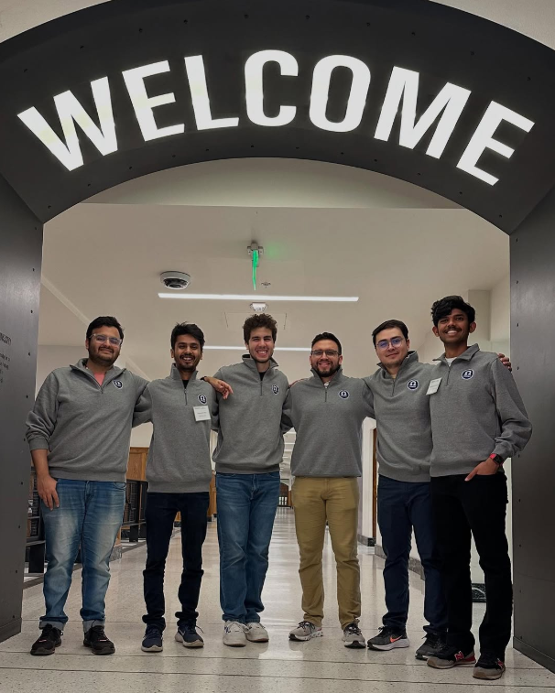
What is OMEGA?
The Official Mechanical Engineering Graduate Association, is a student organization that supports ME grad students through social, academic, and professional events
All ME grad students are automatically members of OMEGA.
We represent your interests in university leadership settings
24-25 Officers at ME grad student visitation day

Slide 3
What does OMEGA do?
Building Social Connections: We organize social events, often in collaboration with other departments, to help ME grad students connect
Academic Enhancement: We support your academic success by hosting study groups and facilitating academic seminars
Mentoring Opportunities: We run mentoring activities that pair experienced grad students with newcomers to help them transition smoothly
Resource Guides: We provide useful links and resources on our website to assist with academic and personal challenges (purdueomega.com/resources/useful-links-contacts)
Representing Students: We ensure your feedback is communicated to ME department and university leadership by actively representing you in leadership settings
Notes:
Lab cookouts
Area exam study sessions
Mentorship circles

Slide 4
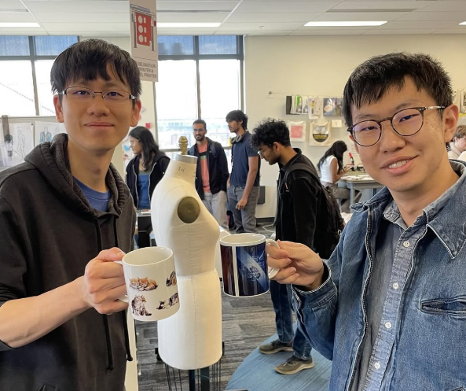
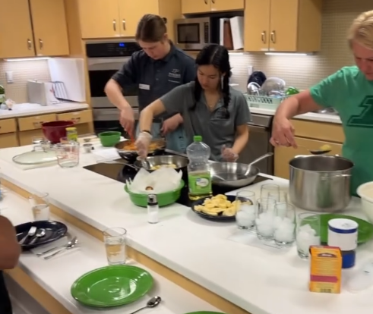
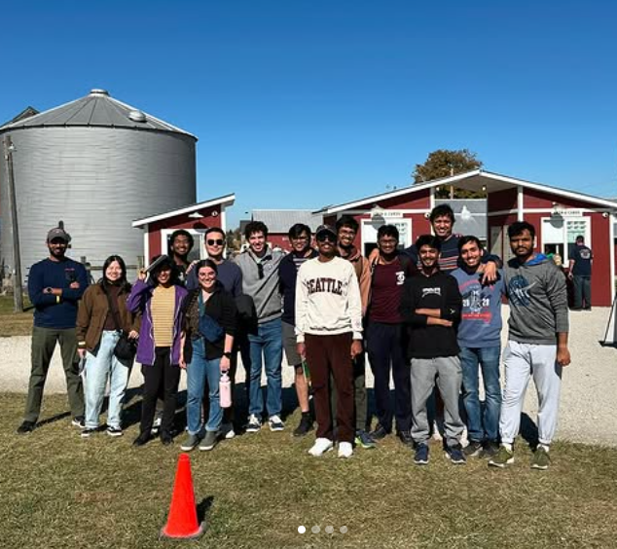
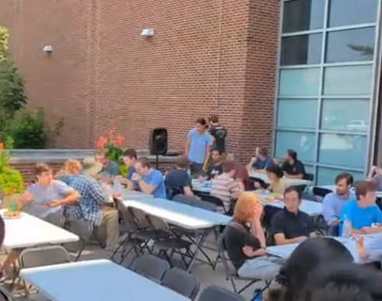
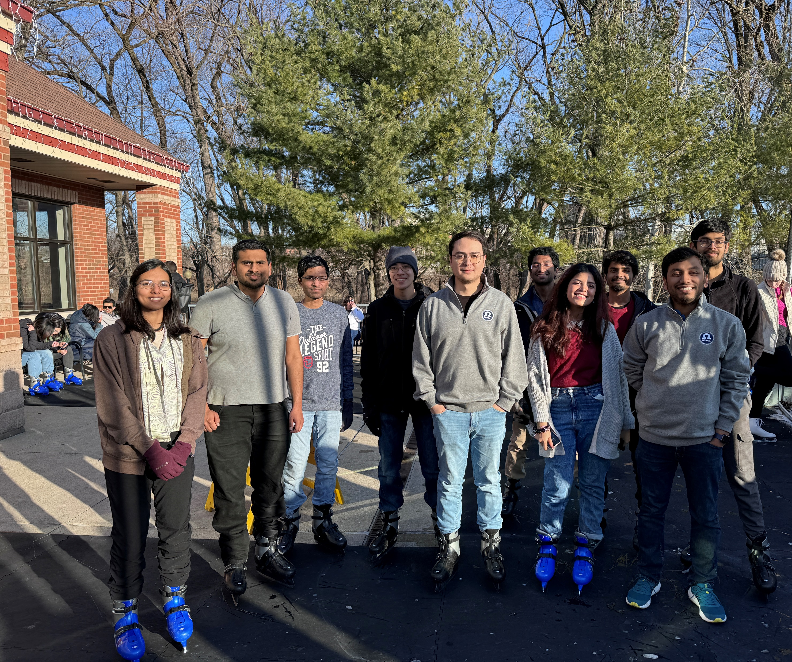
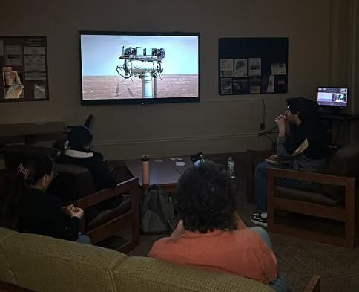
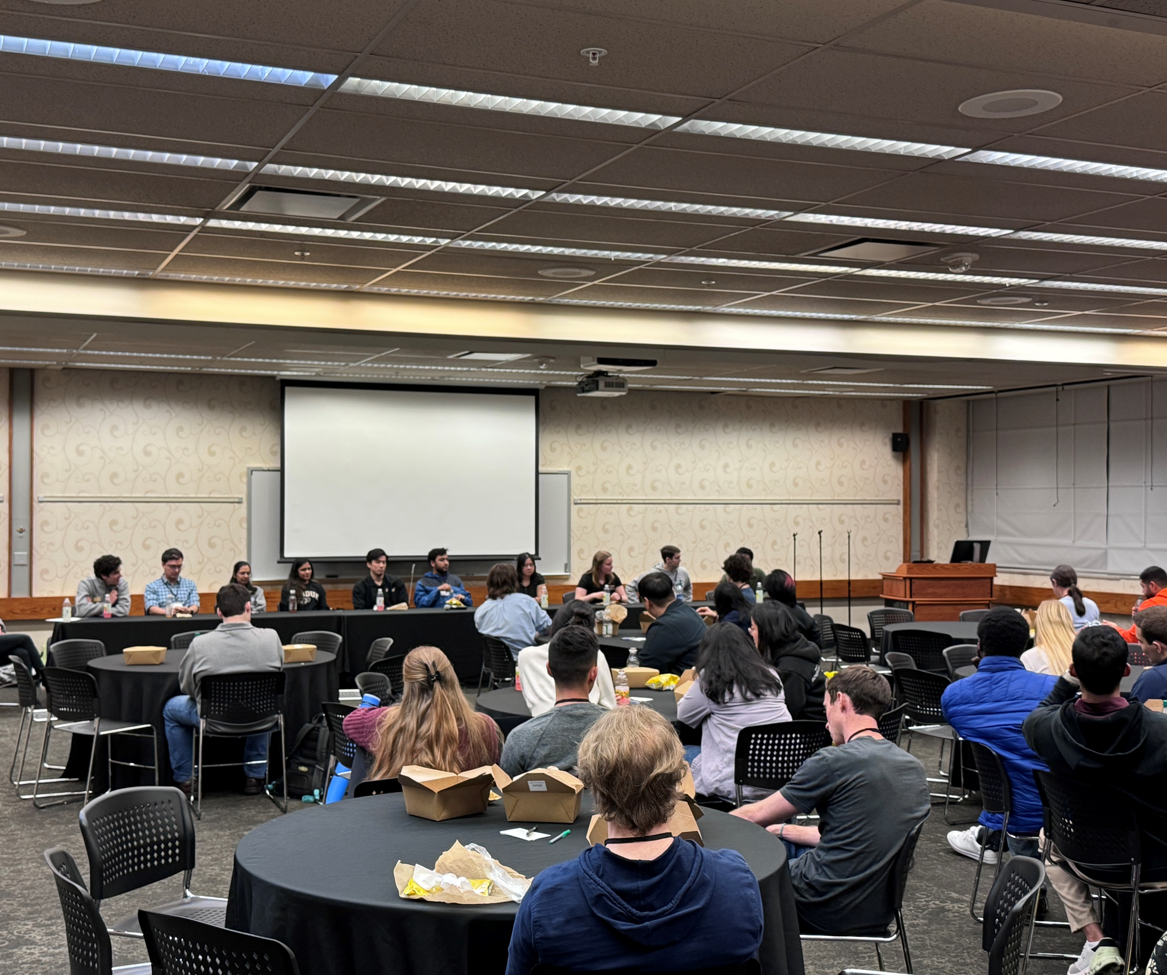
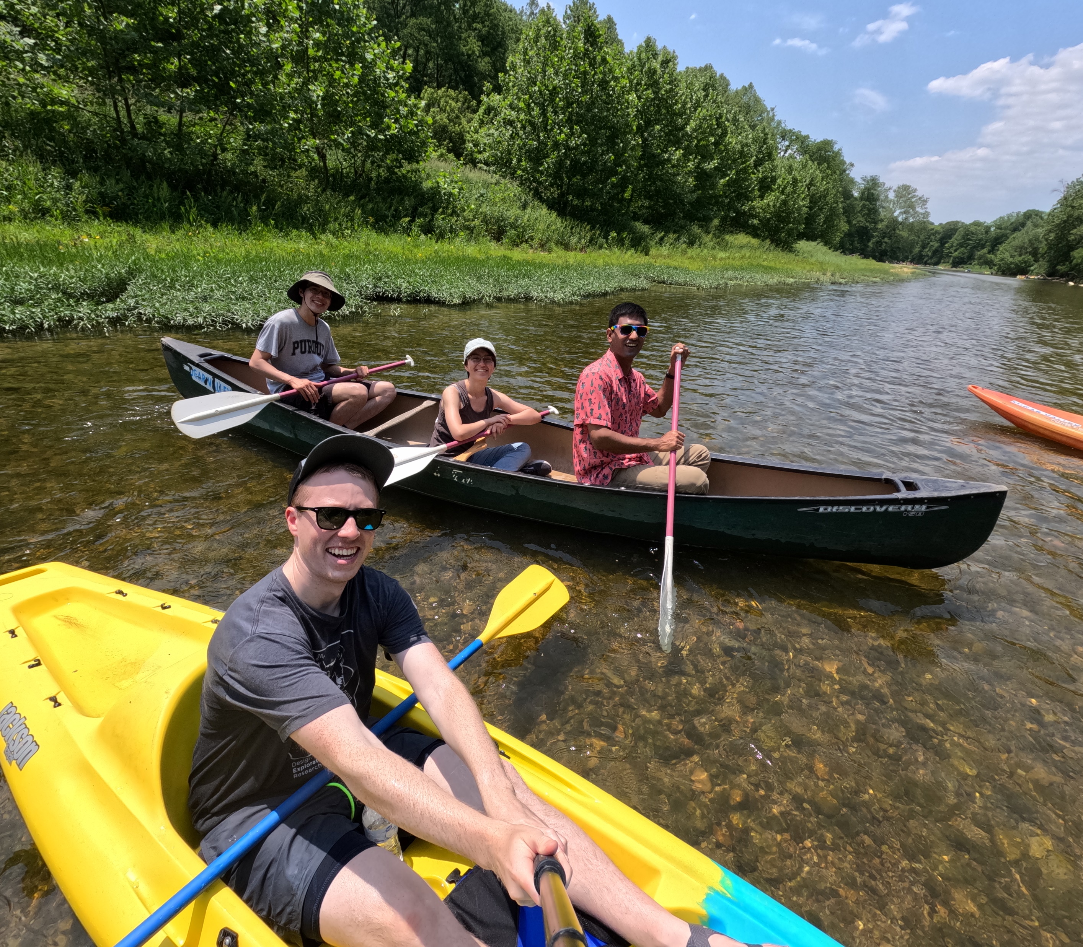
Mug Printing
Apr 2025
Cooking Demo
May 2025
Corn Maze
Oct 2024
Summer Cookout
Jul 2024
Ice skating social
Jan 2024
Movie Night
Nov 2024
Grad Visitation Day
Feb 2024
Canoe Trip
Jun 2023

Slide 5
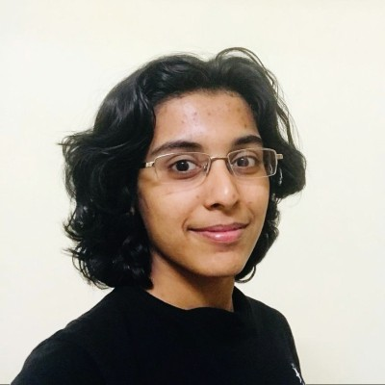

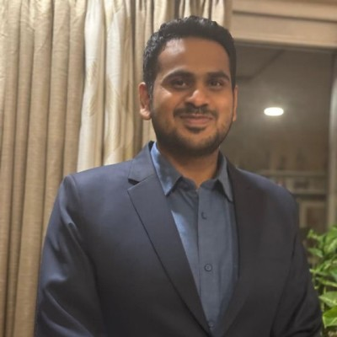
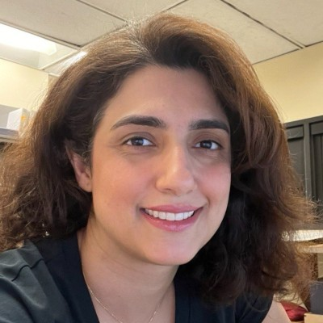
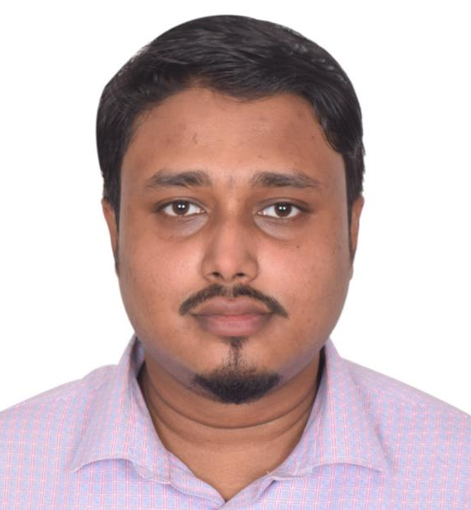
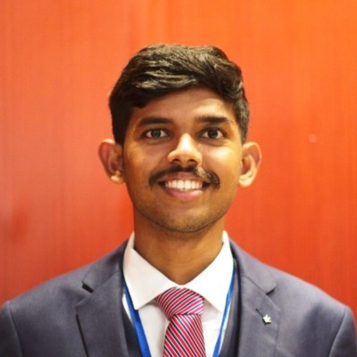
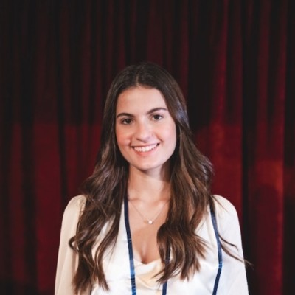
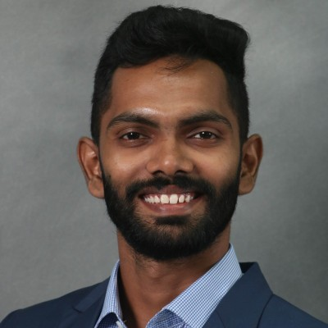
OMEGA Board 24-25
Sneha Srikanth
President
Eugenio Frias-Miranda
Vice-President
Shrihari Pande
Treasurer
Shahrzad Ghadiri
Secretary
Mohammed Abir Mahdi
Academic Chair
Athul C. Dharmarajan
Outreach Chair
Juanita Latorre Jaramillo
Social Media Chair
Chathusha Punchi Wedikkara
PGSG Senator

Slide 6
Committees
Academic - Aims to enhance the academic experience of ME grad students through educational events and resources
  ME290 research tours, Prof/grad student panels to ugrads, Speaker series, mentoring programs, reverse career fair, industry tours
Social - Focuses on building a sense of community and connection among ME grad students through social events and activities
  Socials/watch parties, hikes, IM teams, Cookouts

Slide 7
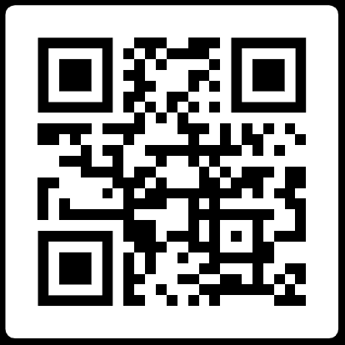
OMEGA Board - How to join?
Officer elections – end of spring term
Contact me (srikan10)!
Follow us on Instagram, LinkedIn
Attend events
We are actively looking to expand the team!
Our Socials
Website: purdueomega.com
Email: puomega@purdue.edu
Insta: puomega
Discord: https://discord.gg/gyyGmftsx8

Slide 8
Thank you!
Website: purdueomega.com
Email: puomega@purdue.edu
Insta: puomega
Discord: https://discord.gg/gyyGmftsx8

