Slide 1
data Management:
The gap between professor’s expectations and graduate student skill levels in data management
Megan Sapp Nelson, Assoc. Professor of Library Sciences
Notes:
Introduction
Started at University of Illinois Geosciences Data Workshop – No one could define what skills graduate students needed to know to manage data
Data Curation Profiles

Slide 2
Today’s Objectives
Define Data Information Literacy
Identify competencies
Explain design of interview instrument
Describe the transcript analysis process
Introduce findings
Discuss implications of findings for graduate education and research advisors

Slide 3
Data Information Literacy
“…Merges the concepts of researcher-as-producer and researcher-as-consumer of data products.”
“It builds upon and reintegrates data, statistical, information, and science data literacy into an emerging skill set.”
In practice, it is a collection of skills that allow an individual to use, create, preserve, and share a data set ethically and efficiently.

Slide 4
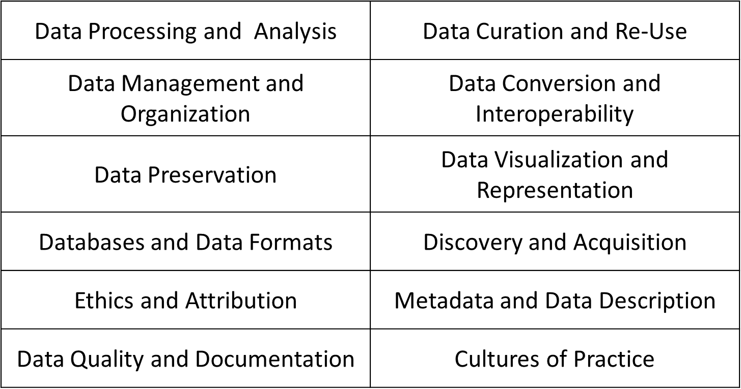
12 competencies
Areas of knowledge for development
Carlson, J., Fosmire, M., Miller, C., & Nelson, M. S. (2011). Determining data information literacy needs: A study of students and research faculty. portal: Libraries and the Academy, 11, 629-657. doi:10.1353/pla.2011.0022
Notes:
Refer to Article pages for definitions.

Slide 5
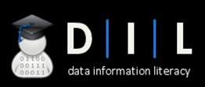

Data Information Literacy Project
DIL Grant
Research Questions:
How appropriate is the list of competencies that we had developed?
What knowledge and skills with data will graduate students need to be successful?
What role could librarians play in teaching these skills?
Grant Overview

Slide 6

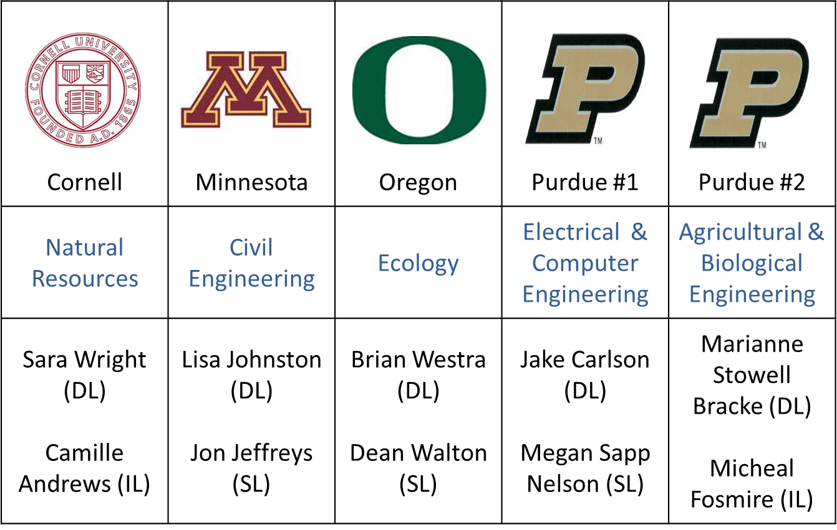

Five Case Studies

Slide 7
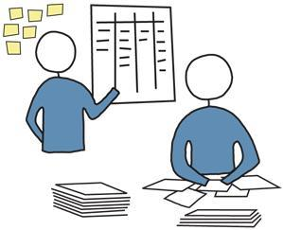
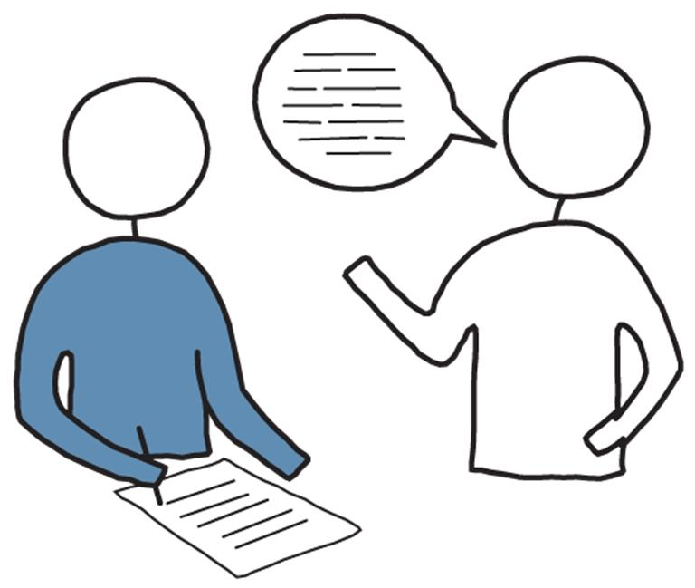
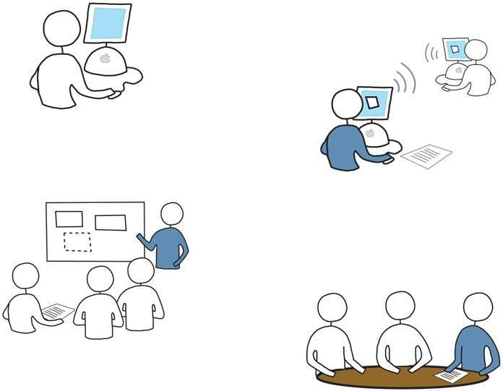
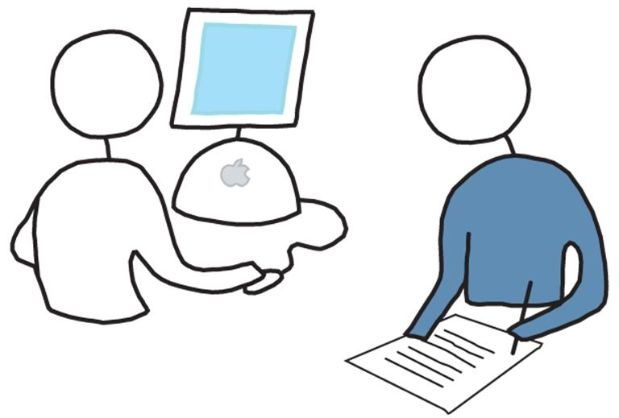

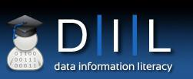
Project Phases
Literature Review
Interviews
Develop Educational Programs
Develop DIL Model
Implement Programs

Slide 8
Interview Instruments
Overview of Development
All interview instruments are available at http://www.datainfolit.org under the Materials tab.
Instrument was based on competencies and organized around research project data management lifecycle.
Semi-structured interview
Standardization
Notes:
Semi-structured interview – Questions were scripted but protocol allowed for follow up questions to elicit more information
Standardization – worksheet and interviewer’s guide

Slide 9
Sample
Convenience sample: People we had previous partnerships with.
Faculty: n = 8
Two faculty members were interviewed in two separate sessions. Therefore “n” can also appear as 9 or 10, since the transcripts for those two interviews were analyzed separately from the initial session.
Graduate students: n = 17

Slide 10
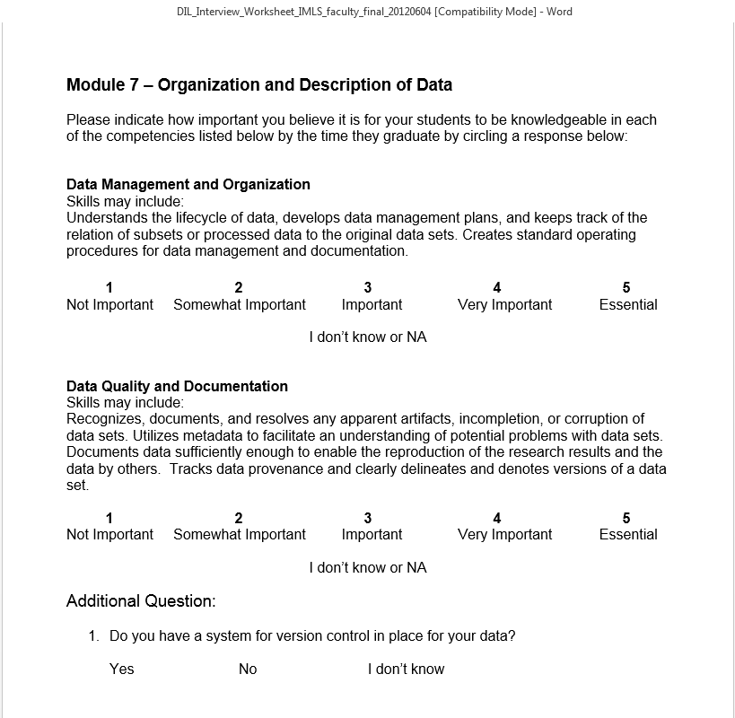
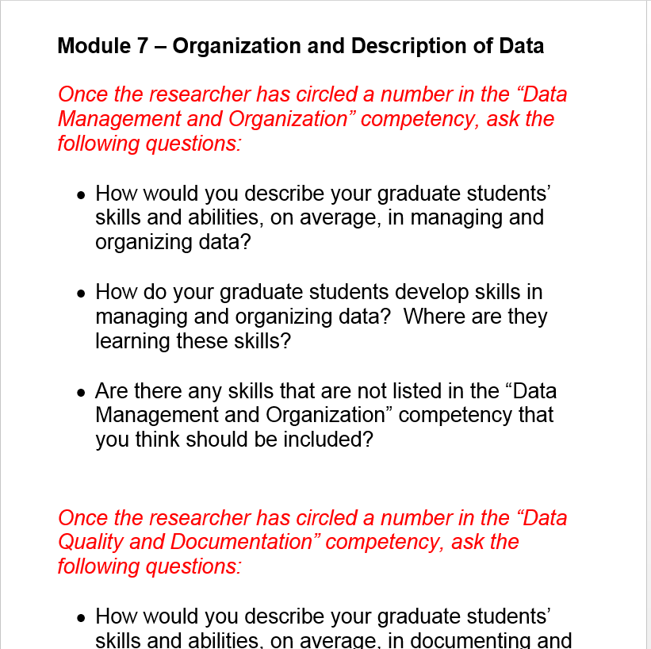
ParticiPant WorkSheet and Interviewer Manual
How the Interview was conducted
Source of analysis
Notes:
Self reporting; perceptions; narrative; audio recorded. Recordings transcribed.

Slide 11
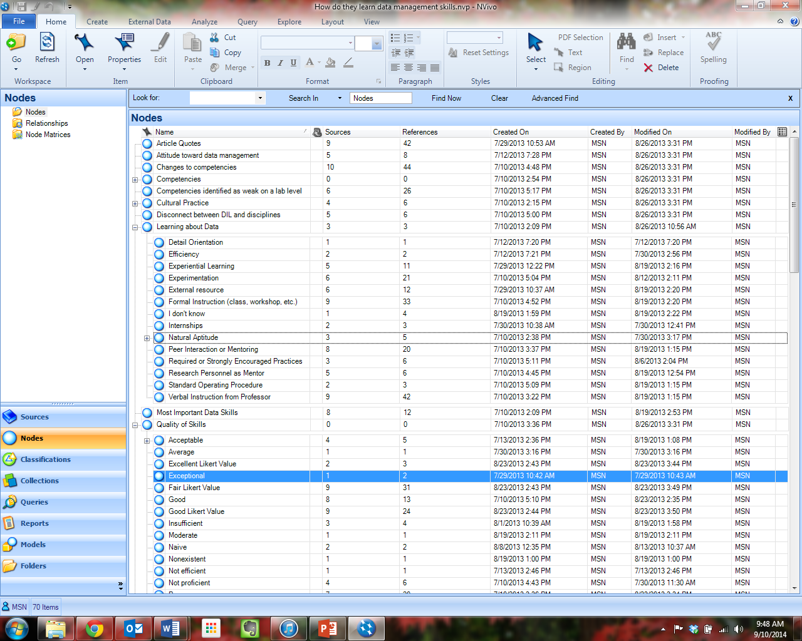
Content Analysis Using Nvivo
Basic Nvivo Setup
Structured nodes based upon interview worksheet.
Unstructured nodes based upon follow- up questions in interviewer manual.
Imposed Likert scale for “Quality of Skills” follow up question to reveal trends.

Slide 12
Learning About Data
(n = 10)

Slide 13
Quality of Skills
Natural Language Description
90 total nodes coded
29
32.2%
Poor
Fair 31
34.4%
Good 24
26.6%
Very Good 4
4.4 %
Excellent 2
2.2 %
Notes:
Lichert scale allowed analysis (binning and trending)

Slide 14
The Gap
http://bit.ly/1qn4Zu6

Slide 15
Interview findings
lack of formal training in data management
lack of formal policies in the lab
self-directed learning through trial and error
focus on data mechanics over concepts
Carlson, J., Johnston, L., Westra, B., & Nichols, M. (2013). Developing an approach for data management education: A report from the data information literacy project. International Journal of Digital Curation, 8(1). 204-217.

Slide 16
Practical Applications of Findings
Strategies for Data Management in your research projects
For Graduate Students | For Research Advisors
Use an online tool such as Mantra or UMN’s Research Data Management Course to get an introduction to DIL. | Use an online tool such as Mantra or UMN’s Research Data Management Course to get an introduction to DIL.
Ask your advisor to see the data management plan for your project – Ask questions! | Take the Data Management Strategies Self Assessment to identify areas of priority to address.
Take the Data Management Micro Self Assessment to identify data management skills to learn. | Use DMPtool.org to develop reusable/editable data management plans.
If you are suggesting using a tool to an advisor, develop docs for your colleagues on how and why it was used. | Consultation with Megan to brainstorm strategies for addressing specific problems.
Back up everything! Ask your advisor about the expectations for backing up files. | Create Standard Operating Procedures for tasks that are repeated consistently by different research staff.
Identify a programming language or tool that is appropriate for your research and develop scripting or analytical skills. | Develop a file naming convention and file structure that is standardized for your lab.

Slide 17
Resources
For more Exploration
Data Information Literacy Project Portal
http://www.datainfolit.org
Data Information Literacy Symposium - http://docs.lib.purdue.edu/dilsymposium/
Carlson, J., Fosmire, M., Miller, C., & Nelson, M. S. (2011). Determining data information literacy needs: A study of students and research faculty. portal: Libraries and the Academy, 11, 629-657. doi:10.1353/pla.2011.0022
Carlson, J., Johnston, L., Westra, B., & Nichols, M. (2013). Developing an approach for data management education: A report from the data information literacy project. International Journal of Digital Curation, 8(1). 204-217.
Research Data Mantra http://datalib.edina.ac.uk/mantra/
UMN Data Management Online Course https://sites.google.com/a/umn.edu/data-management-course_structures/home-1
Coming Soon…
Carlson, J and Johnston, L., ed. (2014). Data Information Literacy: Librarians, data, and the education of a new generation of researchers. West Lafayette, IN: Purdue University Press

Slide 18
Acknowledgements
Granting Agency
Co-Investigators/Co-Authors
Camille Andrews – Cornell University
Jake Carlson - University of Michigan
Michael Fosmire – Purdue University
John Jeffryes – University of Minnesota
Lisa Johnston – University of Minnesota
Dean Walton – University of Oregon
Brian Westra – University of Oregon
Marianne Stowell Bracke – Purdue University
Sarah Wright – Cornell University
Transcriptionists: Dianna Deputy and Sandy Galloway

Slide 19
Acknowledgements
Slide Sources
Some slides adapted from: Carlson, J. and Sapp Nelson, M. (2014) “Data Information Literacy” Committee on Institutional Cooperation (CIC) Library Conference, University of Michigan, Ann Arbor, MI.
Some slides adapted from: Carlson et al. (2013). “DIL Symposium Day 1 Slides” Data Information Literacy Symposium, Purdue University, West Lafayette, IN. Available for download at http://docs.lib.purdue.edu/dilsymposium/2013/presentations/1/

Slide 20
Any Questions
Contact Megan Sapp Nelson at msn@purdue.edu.

