Slide 1



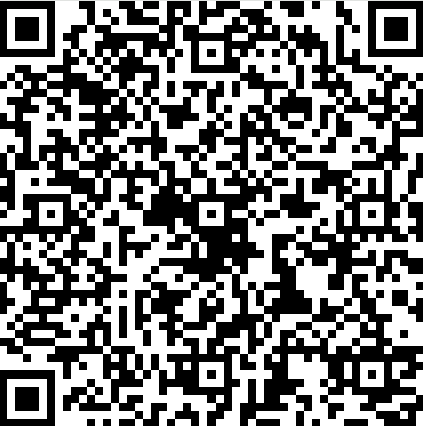
The Aerospace Corporation 2025 Tech Talk– Purdue University
Working at Aerospace means ensuring the safety and success of every government, civil and commercial space mission which means thinking big and aiming high. You’ll work side-by-side with some of the brightest minds in the field who will support you on whatever path your career takes. Join us at our Tech Talk to meet the team and learn about our job opportunities.
Date: Wednesday, September 24, 2025
Time: 6:00pm – 7:00 pm EST
Location: ARMS Room 1103
Registration in Advance: Please use the QR code or the following link Click Here
aerospace.org/careers

